Slide 1
Chapter:13
The Production & Costs

Slide 2
The Production Function
The production function specifies the maximum amount of output that can be produced with a given quantity of inputs. It is defined for a given state of technical knowledge.
The concept of a production function is a useful way of describing the productive capabilities of a firm.

Slide 3
The Production Function Contd.
Mathematically, Y = F (x);
where x = level of input
Y = The maximum level of output
Or more generally, Y = F (K, L)
This equation states that output is a function of the amount of capital and the amount of labor
The production function reflects the available technology for turning capital and labor into output

Slide 4
Production Function
With the available technology This curve shows how output depends on input,
Y
Y = F(x)
2. As more input added, MP declines
1. The slope of production function equals marginal product
x

Slide 5
Total, Average and Marginal Product
Total Product is the total amount of output produced in physical units such as bushels of wheat or number of sneakers.
Marginal Product of an input is the extra product or output produced by 1 additional unit of that input while other inputs are held constant.
For example, assume that we are holding land, machinery and all other inputs constant. Then labor’s marginal product is the extra output obtained by adding 1 unit of labor.
Average Product is the total output divided by total units of input.
Average product of labor or APL = Q/L
This is the accounting measure of productivity.

Slide 6
A numerical example
Units of labor (a) | Total product (b) | Marginal product (c) | Average product(d=b/a)
0 | 0
1 | 2000 | 2000 | 2000
2 | 3000 | 1000 | 1500
3 | 3500 | 500 | 1167
4 | 3800 | 300 | 950
5 | 3900 | 100 | 780

Slide 7
Production Function
This curve shows how output depends on labor input, holding the amount of capital constant
Output, Y
MPL
2. As more labor is added, MPL declines
1
MPL
1
MPL
1. The slope of production function equals marginal product
1
Labor, L

Slide 8
Marginal Product of Labor
Marginal product curve is downward slopping.
Marginal product
MPL = DQ/DL
Measures the output produced by the last worker.
Slope of the production function
Labor

Slide 9
Production Function
Diminishing Marginal Product
  Diminishing marginal product is the property whereby the marginal product of an input declines as the quantity of the input increases.
    Example: As more and more workers are hired at a firm, each additional worker contributes less and less to production because the firm has a limited amount of equipment.

Slide 10
From the Production Function to the Total-Cost Curve
The relationship between the quantity a firm can produce and its costs determines pricing decisions.
The total-cost curve shows this relationship graphically.

Slide 11

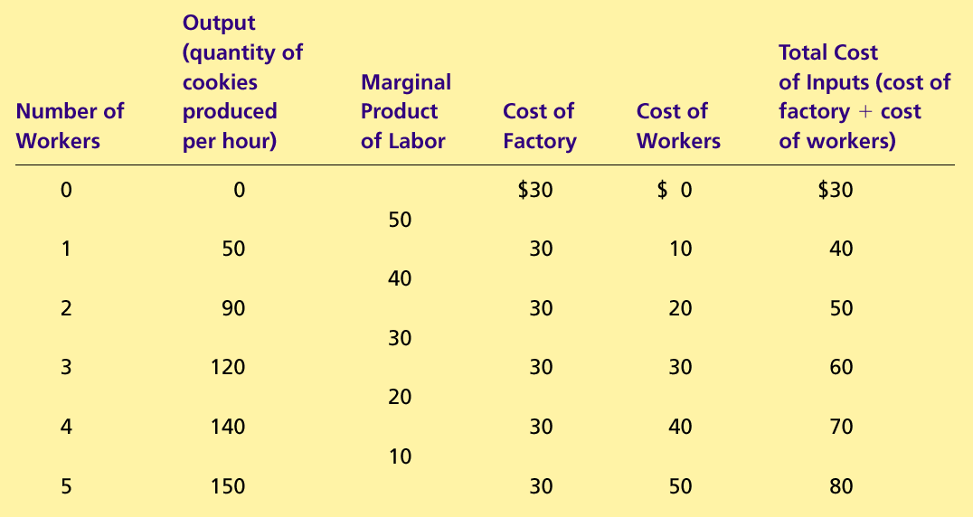
Table 1 A Production Function and Total Cost: Hungry Helen’s Cookie Factory
Copyright©2004 South-Western

Slide 12

Figure : Hungry Helen’s Total-Cost Curve
Total
Cost
$80
Total-cost
curve
70
60
50
40
30
20
10
0
10
20
30
40
50
60
70
80
90
100
110
120
130
140
150
Quantity
of Output
(cookies per hour)
Copyright © 2004 South-Western

Slide 13
THE VARIOUS MEASURES OF COST
Everywhere that production goes, costs follow close behind like a shadow.
Costs of production may be divided into fixed costs and variable costs.
Fixed costs are those costs that do not vary with the quantity of output produced.
Variable costs are those costs that do vary with the quantity of output produced

Slide 14
  Fixed Cost & Variable Cost
$ Cost
TC
  C(Q) = FC + VC
  Total Cost
  =Fixed Cost + Variable Cost
VC(Q)
FC
Q

Slide 15
Figure 4 Thirsty Thelma’s Total-Cost Curves
Total Cost
$15.00
Total-cost curve
14.00
13.00
12.00
11.00
10.00
9.00
8.00
7.00
6.00
5.00
4.00
3.00
2.00
1.00
0
1
2
3
4
5
6
7
8
9
10
Quantity
of Output
(glasses of lemonade per hour)
Copyright © 2004 South-Western

Slide 16
Average Costs
  Average costs can be determined by dividing the firm’s costs by the quantity of output it produces.
  The average cost is the cost of each typical unit of product.
  Average Fixed Costs (AFC)
  Average Variable Costs (AVC)
  Average Total Costs (ATC)
  ATC = AFC + AVC

Slide 17
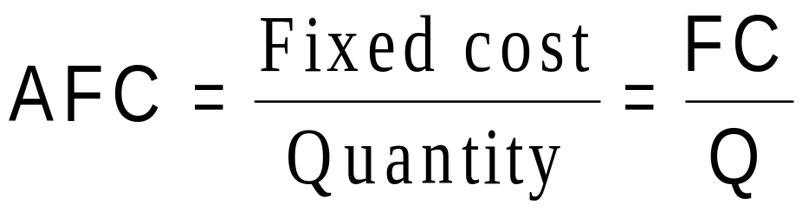
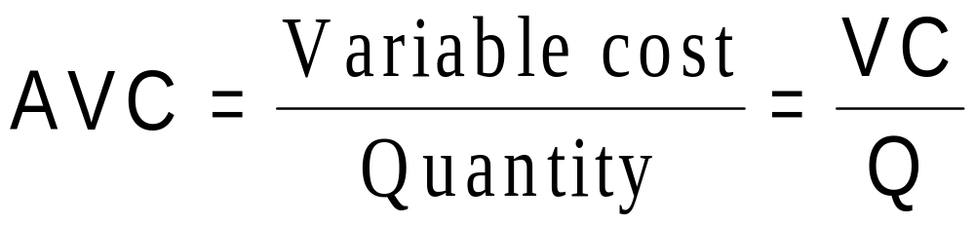
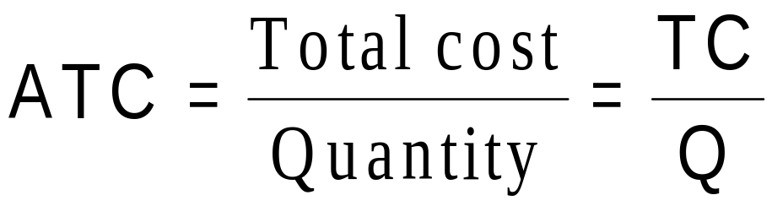
Average Costs

Slide 18
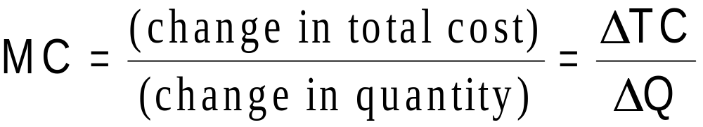
Marginal Cost
  Marginal cost (MC) measures the increase in total cost that arises from an extra unit of production.
  Marginal cost helps answer the following question:
    How much does it cost to produce an additional unit of output?

Slide 19
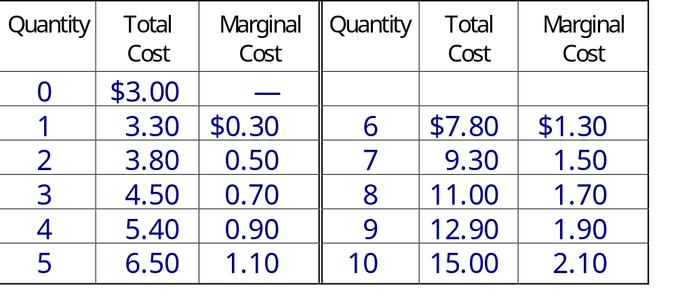
Marginal Cost

Slide 20
Figure 5 Thirsty Thelma’s Average-Cost and Marginal-Cost Curves
Costs
$3.50
3.25
3.00
2.75
2.50
2.25
MC
2.00
1.75
1.50
ATC
1.25
AVC
1.00
0.75
0.50
0.25
AFC
0
1
2
3
4
5
6
7
8
9
10
Quantity
of Output
(glasses of lemonade per hour)
Copyright © 2004 South-Western

Slide 21
Cost Curves and Their Shapes
Marginal cost rises with the amount of output produced.
  This reflects the property of diminishing marginal product.

Slide 22
Figure 5 : Marginal-Cost Curves
Costs
$3.50
3.25
3.00
2.75
2.50
2.25
MC
2.00
1.75
1.50
1.25
1.00
0.75
0.50
0.25
0
1
2
3
4
5
6
7
8
9
10
Quantity
of Output
(glasses of lemonade per hour)
Copyright © 2004 South-Western

Slide 23
Cost Curves and Their Shapes
The average total-cost curve is U-shaped.
At very low levels of output average total cost is high because fixed cost is spread over only a few units.
Average total cost declines as output increases.
Average total cost starts rising because average variable cost rises substantially.

Slide 24
Cost Curves and Their Shapes
The bottom of the U-shaped ATC curve occurs at the quantity that minimizes average total cost. This quantity is sometimes called the efficient scale of the firm.

Slide 25
Cost Curves and Their Shapes
Relationship between Marginal Cost and Average Total Cost
  Whenever marginal cost is less than average total cost, average total cost is falling.
  Whenever marginal cost is greater than average total cost, average total cost is rising.
  The marginal-cost curve crosses the average-total-cost curve at the efficient scale.
    Efficient scale is the quantity that minimizes average total cost.

Slide 26
Figure :Average-Cost and Marginal-Cost Curves
Costs
$3.50
3.25
3.00
2.75
2.50
2.25
MC
2.00
1.75
1.50
ATC
1.25
1.00
0.75
0.50
0.25
0
1
2
3
4
5
6
7
8
9
10
Quantity
of Output
(glasses of lemonade per hour)
Copyright © 2004 South-Western

Slide 27
Typical Cost Curves
Three Important Properties of Cost Curves
  Marginal cost eventually rises with the quantity of output.
  The average-total-cost curve is U-shaped.
  The marginal-cost curve crosses the average-total-cost curve at the minimum of average total cost.

Slide 28
COSTS IN THE SHORT RUN AND IN THE LONG RUN
For many firms, the division of total costs between fixed and variable costs depends on the time horizon being considered.
  In the short run, some costs are fixed.
  In the long run, fixed costs become variable costs.
Because many costs are fixed in the short run but variable in the long run, a firm’s long-run cost curves differ from its short-run cost curves.

Slide 29
Figure 7 Average Total Cost in the Short and Long Run
Average
Total
ATC
in short
ATC
in short
ATC
in short
Cost
run with
run with
run with
small factory
medium factory
large factory
$12,000
ATC
in long run
0
1,200
Quantity of
Cars per Day
Copyright © 2004 South-Western

Slide 30
Economies and diseconomies of scale
Economies of scale – factors that lower average cost as the size of the firm rises in the long run
  Sources: specialization and division of labor, indivisibilities of capital, etc.
Diseconomies of scale – factors that raise average cost as the size of the firm rises in the long run
  Sources: increased cost of managing and coordination as firm size rises
Constant returns to scale – average costs do not change as firm size changes

Slide 31
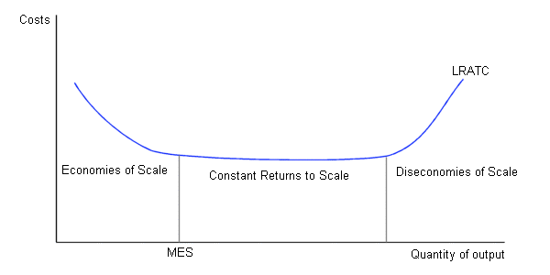
Long-run average total cost (LRATC)

Slide 32

The Firm’s Objective
The Firm’s Objective
  The economic goal of the firm is to maximize profits.
Maximum Profits

Slide 33
Total Revenue, Total Cost, and Profit
Total Revenue
  The amount a firm receives for the sale of its output.
Total Cost
  The market value of the inputs a firm uses in production.

Slide 34
Total Revenue, Total Cost, and Profit
Profit is the firm’s total revenue minus its total cost.
Profit = Total revenue - Total cost

Slide 35
Costs as Opportunity Costs
A firm’s cost of production includes all the opportunity costs of making its output of goods and services.
Explicit and Implicit Costs
  A firm’s cost of production include explicit costs and implicit costs.
    Explicit costs are input costs that require a direct outlay of money by the firm.
    Implicit costs are input costs that do not require an outlay of money by the firm.

Slide 36
Economic Profit versus Accounting Profit
Economists measure a firm’s economic profit as total revenue minus total cost, including both explicit and implicit costs.
Accountants measure the accounting profit as the firm’s total revenue minus only the firm’s explicit costs.
When total revenue exceeds both explicit and implicit costs, the firm earns economic profit.
  Economic profit is smaller than accounting profit.

Slide 37
Figure 1 Economic versus Accountants
How an Economist
How an Accountant
Views a Firm
Views a Firm
Economic
profit
Accounting
profit
Implicit
Revenue
costs
Revenue
Total
opportunity
costs
Explicit
Explicit
costs
costs
Copyright © 2004 South-Western

